Slide 1


SICAS Summit
2017
DROP-IN REPORTING WITH GROOVY
September 2017, Villa Roma

Slide 2
Session Rules of Etiquette
Please silence your mobile device(s)
If you must leave the session early, please do so as discreetly as possible
Please avoid side conversation during this session
Thank you for your cooperation!
SICAS Summit 2017, Villa Roma

Slide 3

Drop-In Reporting with Groovy
Edward Cole
Jamestown Community College
Senior Programmer/Analyst
Almost 25 years of Oracle
16 years of Banner
Jamestown Community College
SICAS Summit 2017, Villa Roma

Slide 4
A Real Problem – A Real Solution
Oracle Reports is Going Away
Oracle Reports primary reporting tool since we started using Oracle almost 25 years ago
Over 600 Oracle Reports applications in 15 years
Oracle giving gentle hints that we should move on
Not good at producing data extracts, which users prefer
Jamestown Community College
SICAS Summit 2017, Villa Roma

Slide 5
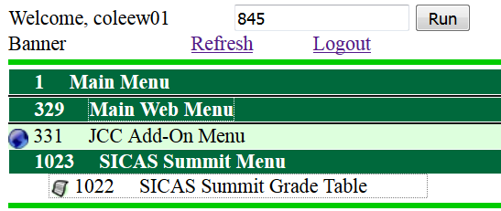
A Practical Reporting Tool
Reports – from the user’s point of view
User selects #1022: SICAS Summit Grade Table from our menu
Jamestown Community College
SICAS Summit 2017, Villa Roma

Slide 6
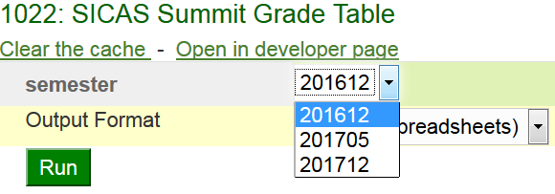
A Practical Reporting Tool
A parameter form opens up with a list of values for the semester
User runs the application with the output format set to CSV (for spreadsheets)
Jamestown Community College
SICAS Summit 2017, Villa Roma

Slide 7
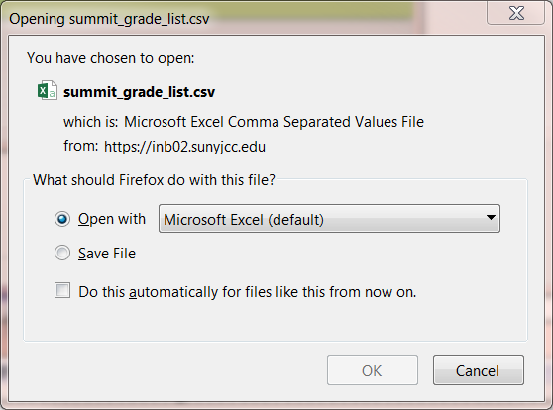
A Practical Reporting Tool
Jamestown Community College
SICAS Summit 2017, Villa Roma

Slide 8
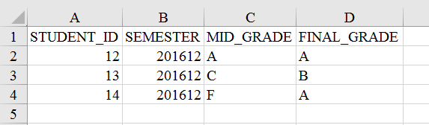
A Practical Reporting Tool
Our data:
The interesting part is what you can’t see
Jamestown Community College
SICAS Summit 2017, Villa Roma

Slide 9
Pause for effect...
Jamestown Community College
SICAS Summit 2017, Villa Roma

Slide 10
The interesting part…
… this only took 8 lines of code
report(title: "Summit Grade List") {
param(name: "semester", label: "semester") {
list_of_values query: """select distinct semester
from summit_grades"""
}
sql query: """select * from summit_grades
where semester = :semester"""
}
You just save this file as summit_grade_list.groovy
and “drop it in” to the right directory
[Full disclosure: It has to be added to the menu separately]
Jamestown Community College
SICAS Summit 2017, Villa Roma

Slide 11
It Started with a Dream…
Many reports are just SQL queries with enough wiring to deliver the output to our users
What if we could drop our query into a container that collects the parameters from our users and return the formatted output to them?
What if we could use a simple DSL (Domain-specific language) to define the reports that are more complicated than one can do comfortably with a single select statement?
Jamestown Community College
SICAS Summit 2017, Villa Roma

Slide 12
Cold Reality Also Played a Part
Practical considerations to our reporting tool
Free or open source tools
No licensing fees
High quality
Widely used and not tied to a single vendor.
Freedom
We own our own reports
Not locked away on a web server
Not in a binary format
No IDE
Jamestown Community College
SICAS Summit 2017, Villa Roma

Slide 13
Making the Dream a Reality
Jamestown Community College
SICAS Summit 2017, Villa Roma

Slide 14
What is this reporting system?
A Java Library (JAR file), written in Groovy creates and runs the reports
A Grails application handles the interaction with client
Report definitions stored in a directory on the server
Protected by Git
Easy to search, edit, or modify through common tools
No binary formats
Paper reports created by Jasper Reports
Jamestown Community College
SICAS Summit 2017, Villa Roma

Slide 15
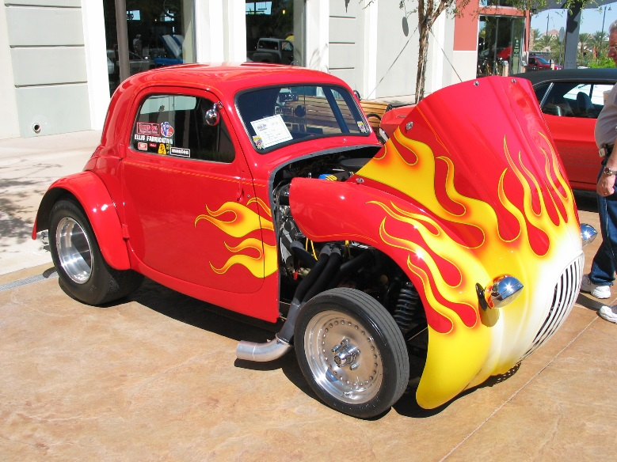
What is Groovy?
Groovy is a chopped, channeled, lowered, louvered and flame-painted Java
noego (https://commons.wikimedia.org/wiki/File:Fiat_Topolino_hotrod_front.jpg), „Fiat Topolino hotrod front“, https://creativecommons.org/licenses/by/2.0/legalcode
Jamestown Community College
SICAS Summit 2017, Villa Roma

Slide 16
Groovy extends Java
Most Java code will compile and run correctly as Groovy without any changes
Interacts seamlessly with Java code
Gives you access to the enormous library of software available for the JVM
Runs without recompilation on all major operating systems
Jamestown Community College
SICAS Summit 2017, Villa Roma

Slide 17

Why Groovy is groovy
Groovy gives us the following special features
Easy-to-use interface for SQL and XML
Closures and functional programming
Scripting
Builders and DSL’s
“Easy” web applications through Grails
Jamestown Community College
SICAS Summit 2017, Villa Roma

Slide 18
The Grails Application
The library contains no user interaction
The Grails application is the client interface
Gathering parameters
Delivering output
Controlling access using the JCC menu system
Other client interfaces are possible and might be added in the future
Jamestown Community College
SICAS Summit 2017, Villa Roma

Slide 19
Jasper Reports
It is a fully-functional report generator
It is Java-Based and you can include it in Java programs
It has XML source code
You can develop it through either a GUI or a text editor
It is FREE
Jamestown Community College
SICAS Summit 2017, Villa Roma

Slide 20
Example Reports
Examples from the developer’s point of view
Plain SQL
A Groovy report with an SQL query
Dynamic SQL
A report with data created from arbitrary Groovy code
Jamestown Community College
SICAS Summit 2017, Villa Roma

Slide 21
A Pure SQL Report
sql/summit_dict_tables.sql
/* List all data dictionary tables matching the pattern */
select * from dictionary
where table_name like
nvl(upper(:table_name),'%')
order by table_name
Note the bind variable in the query, :table_name
When we run the report, it displays a parameter form which asks for a table name.
Jamestown Community College
SICAS Summit 2017, Villa Roma

Slide 22
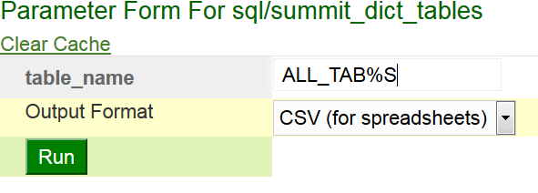
A Pure SQL Report
Enter ALL_TAB%S, to get a list of table-related data dictionary objects and run the report
Jamestown Community College
SICAS Summit 2017, Villa Roma

Slide 23
A Pure SQL Report
TABLE_NAME | COMMENTS
ALL_TABLES | Description of relational tables accessible to the user
ALL_TAB_COLS | Columns of user's tables, views and clusters
ALL_TAB_COLUMNS | Columns of user's tables, views and clusters
ALL_TAB_COL_STATISTICS | Columns of user's tables, views and clusters
ALL_TAB_COMMENTS | Comments on tables and views accessible to the user
Jamestown Community College
SICAS Summit 2017, Villa Roma

Slide 24
Groovy Example
How you create a report using my DSL
The syntax is nothing more than Groovy
I’ve created special methods which we will use as keywords to build reports
Building the example up piece by piece
Jamestown Community College
SICAS Summit 2017, Villa Roma

Slide 25
Groovy Example
A report listing tables belonging to a particular database schema and matching a given pattern
First, tell the builder that we are creating a report
report(title: 'List User Tables') {
// Parameters, data generators and other
// interesting things will go here.
}
The “report” keyword starts the creation of a new report
Jamestown Community College
SICAS Summit 2017, Villa Roma

Slide 26
Define a parameter named “owner” with a list of values
// Create a parameter for owner of the table
param(name: 'owner', label: 'Owner') {
// Add a list of values that excludes
// Oracle schemas and schemas that don't
// own any tables
list_of_values query: """
select username from all_users
where oracle_maintained = 'N'
intersect select owner from all_tables"""
}
“param” creates a field on the parameter form
“list_of_values” creates a pull-down list with a set of possible values for the owner parameter
Jamestown Community College
SICAS Summit 2017, Villa Roma

Slide 27
Groovy Example
Add a second parameter
// A second parameter for the table name.
// Make it default to '%'
param(name: 'table_name',
label: 'Table Name',
description: 'List tables matching this value,
with Oracle wildcards.', 'default': '%')
Jamestown Community College
SICAS Summit 2017, Villa Roma

Slide 28
Groovy Example
Finally, add a query that references the parameters
sql query: """
select table_name, comments
from all_tab_comments
where owner = :owner
and table_name like
upper(nvl(:table_name,'%'))
and comments is not null
order by table_name"""
The “sql” method tells us to use the SQL query as the source of our data
Jamestown Community College
SICAS Summit 2017, Villa Roma

Slide 29
/** A report that lists the tables belonging to a particular schema */
report(title: 'List User Tables') {
// Create a parameter for the owner of the table
param(name: 'owner', label: 'Owner') {
// Add a list of values that excludes Oracle schemas and
// schemas that don't own any tables
list_of_values query: """select username
from all_users
where oracle_maintained = 'N'
intersect
select owner from all_tables"""
}
Jamestown Community College
SICAS Summit 2017, Villa Roma

Slide 30
// A second parameter for the table name. Make it default to '%'
param(name: 'table_name',
label: 'Table Name',
description: 'List tables matching this value,
with Oracle wildcards.', 'default': '%')
// Get the data from an SQL query. This references the
// parameters with a colon.
sql query: """select table_name, comments
from all_tab_comments
where owner = :owner
and table_name like upper(nvl(:table_name,'%'))
and comments is not null
order by table_name"""
}
Jamestown Community College
SICAS Summit 2017, Villa Roma

Slide 31
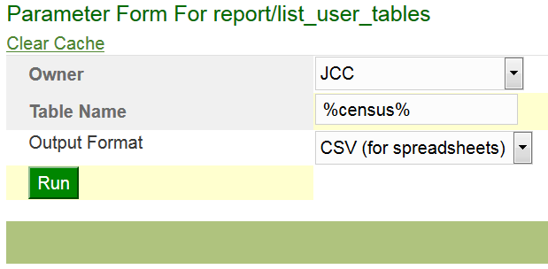
Groovy Example
When we run it, we see the following parameter form
The select statement has turned into a pull-down list.
Jamestown Community College
SICAS Summit 2017, Villa Roma

Slide 32
Groovy Example
The report returns the following data
TABLE_NAME | COMMENTS
T_CENSUS_ROSTER | This table has one row per course per term.
T_STU_CENSUS_ROSTER | The roster of students in this course
Jamestown Community College
SICAS Summit 2017, Villa Roma

Slide 33
Dynamic SQL Example
A dynamic SQL report allows you to create your query after you have seen the parameters
Sample Data
(SUMMIT_GRADES) Table created for this example
STUDENT_ID | SEMESTER | MID_GRADE | FINAL_GRADE
12 | 201612 | A | A
13 | 201612 | C | B
14 | 201612 | F | A
12 | 201705 | B | A
13 | 201705 | C | A
15 | 201712 | F | D
Jamestown Community College
SICAS Summit 2017, Villa Roma

Slide 34
Parameters
report(title: "Grade Totals") {
mid_or_final determines grade column used
grade singles out one grade for special treatment
param(name: 'mid_or_final',
label: "Show Midterm or Final Grade?", 'default': 'F') {
list_of_values values: [['F', 'Final'],
['M', 'Midterm']]
}
param(name: 'grade',
label: 'What grade do we report on?',
'default': 'F') {
list_of_values values: ('A'..'F').collect{[it, it]}
}
Jamestown Community College
SICAS Summit 2017, Villa Roma

Slide 35
Dynamic SQL Example
The query text is replaced by a function that returns the SQL text
// The data source for this report is a dynamic SQL query.
// The dynamic_sql method takes a closure as an argument.
// This one will use the value of the mid_or_final parameter
// to choose which grade column to report on, and it will
// also use the grade parameter to set one of the column names.
dynamic_sql sql_closure: {
params ->
// Get the parameters from the closure arguments.
String mid_or_final = params.mid_or_final;
String grade = ('A'..'F').contains(params.grade)?params.grade:'F';
Jamestown Community College
SICAS Summit 2017, Villa Roma

Slide 36
Dynamic SQL Example
The query text is replaced by a function that returns the SQL text
// Set the grade column
String grade_column = (mid_or_final == 'M')?'mid_grade':'final_grade'
// Return an SQL query. """
select semester,
count(${grade_column}) as ${grade_column},
sum(decode(${grade_column}, :grade, 1, 0)
) ${grade}_grades
from summit_grades
group by semester
order by semester """
}
Jamestown Community College
SICAS Summit 2017, Villa Roma

Slide 37
select semester, count(mid_grade) as mid_grade, sum(decode(mid_grade, :grade, 1, 0) ) F_grades from summit_grades group by semester order by semester
Dynamic SQL Example
Run the report
:mid_or_final = 'M'
:grade = 'F‘
The closure returns the following SQL text
select semester,
count(mid_grade) as mid_grade,
sum(decode(mid_grade, :grade, 1, 0) ) F_grades
from summit_grades
group by semester
order by semester
Jamestown Community College
SICAS Summit 2017, Villa Roma

Slide 38
select semester, count(mid_grade) as mid_grade, sum(decode(mid_grade, :grade, 1, 0) ) F_grades from summit_grades group by semester order by semester
Dynamic SQL Example
Which generates the following data
SEMESTER | MID_GRADE | F_GRADES
201612 | 3 | 1
201705 | 2 | 0
201712 | 1 | 1
Jamestown Community College
SICAS Summit 2017, Villa Roma

Slide 39
Closure Query Example
You can generate your report data from arbitrary Groovy code
An example that’s hard to do in most reporting tools
Suppose that we have a table with SQL queries
SQL> select * from summit_sql;
We will create a report that lists the queries in this table that have errors
ID | SQL_QUERY
1 | select user from dual
2 | select sloozle from fleem
Jamestown Community College
SICAS Summit 2017, Villa Roma

Slide 40
Closure Query Example
Define a data_generator closure to create the report data
You need to declare the columns of the result set
report(title: "Invalid Summit Queries") {
// Specify a closure to return the report data.
data_generator closure: {
// We have to define the columns explicitly
column(name: 'id', label: "ID");
column(name: 'sql_query', label: "SQL Query");
column(name: 'error', label: "Error");
Jamestown Community College
SICAS Summit 2017, Villa Roma

Slide 41
Closure Query Example
The script’s environment will provide a database connection. We’ll use it to loop through the rows of the table and test the queries therein.
// "sql" is a pre-defined groovy.sql.SQL object
def queries = sql.rows(
"select * from summit_sql order by id");
// Loop through all the rows in the table and
// test each query
queries.each {
q ->
Prepare a row to return if the query has a problem.
query_row = [id: q.id,
sql_query: q.sql_query,
error: ''];
Jamestown Community College
SICAS Summit 2017, Villa Roma

Slide 42
Closure Query Example
// Test the query from the table by invoking explain_plan. If
// the query fails to compile, it will throw a SQLException.
try {
// Beware of Groovy's GString
String explainQuery = "explain plan for ${q.sql_query}"
sql.execute(explainQuery);
} catch (java.sql.SQLException e) {
query_row.error = e.getMessage();
}
if (query_row.error?.size()) {
// "row" is a predefined method that add a row
// to the result set.
row(query_row);
}
Jamestown Community College
SICAS Summit 2017, Villa Roma

Slide 43
Closure Query Example
When we run the report, we get a list of invalid SQL queries.
Note: This example was inspired by a real-life problem.
id | sql_query | error
2 | select sloozle from fleem | ORA-00942: table or view does not exist
Jamestown Community College
SICAS Summit 2017, Villa Roma

Slide 44
Jasper Reports
Design reports in the GUI developer environment and save them as .jrxml (a schema of XML)
Text-based
Extract parameters, subreports, and images using standard XML tools
Look for existing parameter forms with same name
Compile reports before running them
Use Jasper Reports to run the report and format the output
Jamestown Community College
SICAS Summit 2017, Villa Roma

Slide 45
Implementation
Jamestown Community College
SICAS Summit 2017, Villa Roma

Slide 46
Groovy Closures & Delegation
Closures
They are functions that can be used like all other variables
Delegates
A Groovy method (i.e. a block of Groovy Code) can reference things that don’t exist at the time the code was compiled
You can specify that it look for the missing methods and properties in another object, called the delegate
Jamestown Community College
SICAS Summit 2017, Villa Roma

Slide 47
Builders Instance of groovy.util.BuilderSupport
Keep track of the tree structure implicit within Groovy code
report(title: "Sample report") {
// When this closure executes, the parent node will be the object created
// by the report method.
param(name: "sample_parameter") {
// When this closure is executed, the parent node will be the parameter
// created by the param method.
}
}
Requires you to implement three methods
createNode
addParent
nodeCompleted
Jamestown Community College
SICAS Summit 2017, Villa Roma

Slide 48
Into the code
Here are a few of the key classes in the package
SourceFactory
Fetches the source code for reports (returned as a String)
ReportObjectFactory
Gets the source code from a SourceFactory and calls the eval method on a SimpleReportBuilder to create the requested object
SimpleReportBuilder
Executes a build script and returns the object that is created
Jamestown Community College
SICAS Summit 2017, Villa Roma

Slide 49
SimpleReportBuilder – eval
/** Evaluate a report builder script and return the results */
def eval(String text) {
def shell = new GroovyShell()
try {
// Wrap the text in a closure so that it doesn't execute
// immediately. This gives us the chance to change
// its delegate.
Closure c = shell.evaluate("{->$text}")
c.setDelegate(this)
// Execute the build script and add the
// source code to the object created.
def b = c()
if (b instanceof Buildable) {
b.source = text
}
return b;
} catch (BuildException e) {
e.source = text;
throw e
}}
Jamestown Community College
SICAS Summit 2017, Villa Roma

Slide 50
SimpleReportBuilder
The createNode method uses an associative array (hash map) of functions to create a new object
Object createNode(Object name, Map attributes,
Object value) {
if (!nodeFactory[name]) {
throw new BuildException("'$name' is not a valid build method. Valid values are ["
+ nodeFactory.keySet().join(', ') + "]");
}
assert name in nodeFactory.keySet()
def n = nodeFactory[name].create(name, attributes,
value)
return n
}
Jamestown Community College
SICAS Summit 2017, Villa Roma

Slide 51
SimpleReportBuilder
Sample of the functions called by createNode
private nodeFactory = [
report: [
create: {
String name, Map attributes, def value ->
def report = new SimpleReport(attributes)
assert report
if (value) {
report.description = value
}
return report
},
implClass: SimpleReport,
],
Jamestown Community College
SICAS Summit 2017, Villa Roma

Slide 52
SimpleReportBuilder
The setParent method uses a two-dimensional array keyed by parent and child class
void setParent(Object parent, Object child) {
def parentClass = parent.getClass()
def farm = addChildFarm[parent.getClass()]
if (! farm[child.getClass()]) {
def parentMethod = classMethodNames[parentClass]
def childMethod = classMethodNames[child.getClass()]
throw new BuildException("You cannot embed a $childMethod within a $parentMethod. "
+ "Valid options are: [${farm.keySet().collect { classMethodNames[it]}.join(',')}]")
}
def z = farm[child.getClass()](parent, child)
debug "z=$z"
z
}
(classMethodNames is a map from the report object class to the keyword used to build it. It is used here to produce a meaningful error message.)
Jamestown Community College
SICAS Summit 2017, Villa Roma

Slide 53
SimpleReportBuilder
Here is a sample from the addChildFarm used by setParent
/** Each entry in this table is a closure that attaches the child to the
* parent. The keys for the map are a subset of the cross-product of the
* classes that can go into a SimpleReport.
*
* Note that the keys of the map are actual Java classes, not their names.
* It is very important that they be wrapped in parentheses.
*/
Jamestown Community College
SICAS Summit 2017, Villa Roma

Slide 54
SimpleReportBuilder
def addChildFarm = [
(SimpleReport): [
(Param): {
parent, child ->
parent.addParam(child)
},
(ParamForm): {
parent, child ->
assert !parent.params
parent.params = child
}
Jamestown Community College
SICAS Summit 2017, Villa Roma

Slide 55

Tell me more!
The simple report library is available at
https://github.com/ewcole/simple_report
I can share the Grails application with you upon request
Edward Cole
Senior Programmer/Analyst
EdCole@mail.sunyjcc.edu
SICAS Summit 2017, Villa Roma

